Slide 1




Entrepreneurship and
Small Business Management
Becoming an Entrepreneur
Small Business Basics
Starting a Small Business
SLIDE 1

Slide 2
Becoming an Entrepreneur
Goal 1
Goal 2
Goal 3
Identify characteristics of successful entrepreneurs.
Recognize the importance of entrepreneurship in the economy. Describe opportunities and risks of entrepreneurship.
SLIDE 2
Notes:
If I want to become a entrepreneur I have to keep in mind 3 goals.
Identify , Recognize and Describe

Slide 3
WHAT is ENTREPRENEURSHIP?
Entrepreneurship – • Accepting the risk of starting and running a
business.

Slide 4
Who is an entrepreneur?
Person conducting own business (Webster)
Person who sets up business deals in order to make profits (Collins Cobuild)
Organizer of an economic venture, one who owns, organizes, manages, and assumes the risks of the business (Chandrashekhar)

Slide 5
Why entrepreneurship?
Process of creating something different, with value, by devoting necessary time and effort, by assuming the accompanying financial, psychological, and social risks, and receiving the resulting rewards of monetary and personal satisfaction (Bowen and Hisrich, 1986).

Slide 6
Role of the Entrepreneur
An innovator who combines technical innovations and financial finesses. Important role in producing competitive products, processes, and services. Generation of new employment Local and regional economic development Improved allocation of resources and transfer of technologies

Slide 7
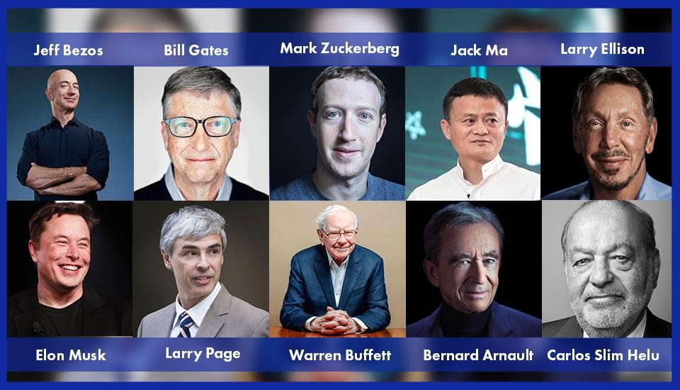
NOTABLE ENTREPRENEURS

Slide 8
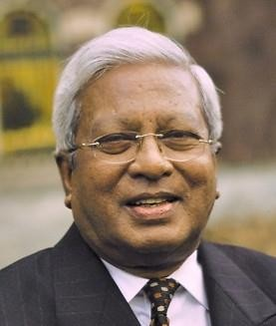
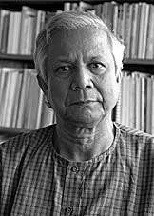
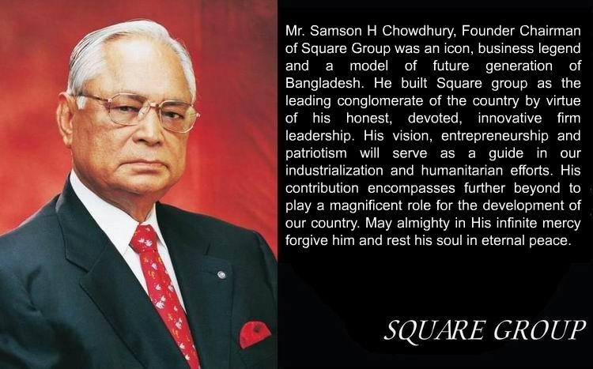
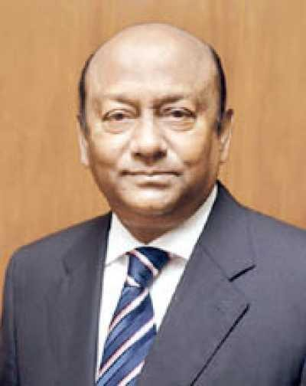
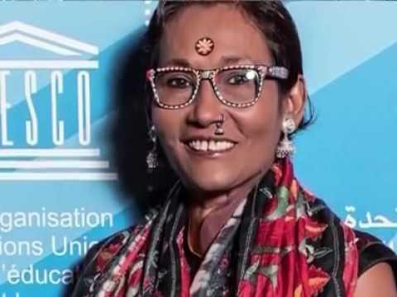
Famous Entrepreneurs – Bangladesh
Muhammad Yunus
Fazle Hasan Abed
Latifur Rahman
Bibi Russel

Slide 9
YOU’RE NEVER TOO YOUNG to be an
ENTREPRENEUR (Spotlight on Small Business)
Leanna Archer – At 12 years old, she has her own hair care line.
Alexis Holmes – Started baking for a fundraiser, now the 16-year-old owns her own bakery.
Jack Short & Daniel Lyons – The two medical students started Factory Green, a carbon neutral apparel company, as undergrads.
Mark Zuckerberg – Launched Facebook as a Harvard freshman.

Slide 10
KEY TERMS
Entrepreneur- the individual that is a risk taker and innovator.
Entrepreneurship- the business that is creative and risky.
Characteristics: Creative, confident, goal-oriented, motivated, hard-working
Risks: Unproven idea, little management experience, long-hours with no guarantee of a profit

Slide 11
KEY TERMS
Venture Capital- Money provided by large investors to finance new products and new businesses that have a good chance to be very profitable
*Innovation- a brand new creation or invention
*Improvements- a significant design change or addition on an existing product

Slide 12
Entrepreneurship VS Working for others
Entrepreneurship
Own the business
Freedom to succeed as well as freedom to fail
Do not receive any benefits such as paid vacation time, day care, a company car or health insurance.
Working for others
Somebody else assumes entrepreneurial risk
Provides with benefits such as paid vacation and health insurance.
Notes:
In Entrepreneurship you have to own the business,have huge liability,have minimum fringe benefits and have to be accountable for success and failure.
Whereas, working for others you don’t have to own ,have liability and enjoy many benefits.

Slide 13
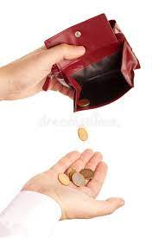


3 Reasons most small businesses fail
Lack of money
Lack of management experience
Not keeping adequate records
Notes:
3 reasons your small business can fall.
1.Lack of money
2.Lack of management capability
3. Lack of adequate records

Slide 14

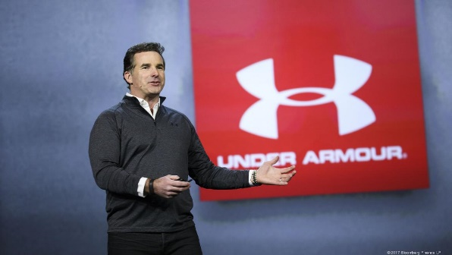
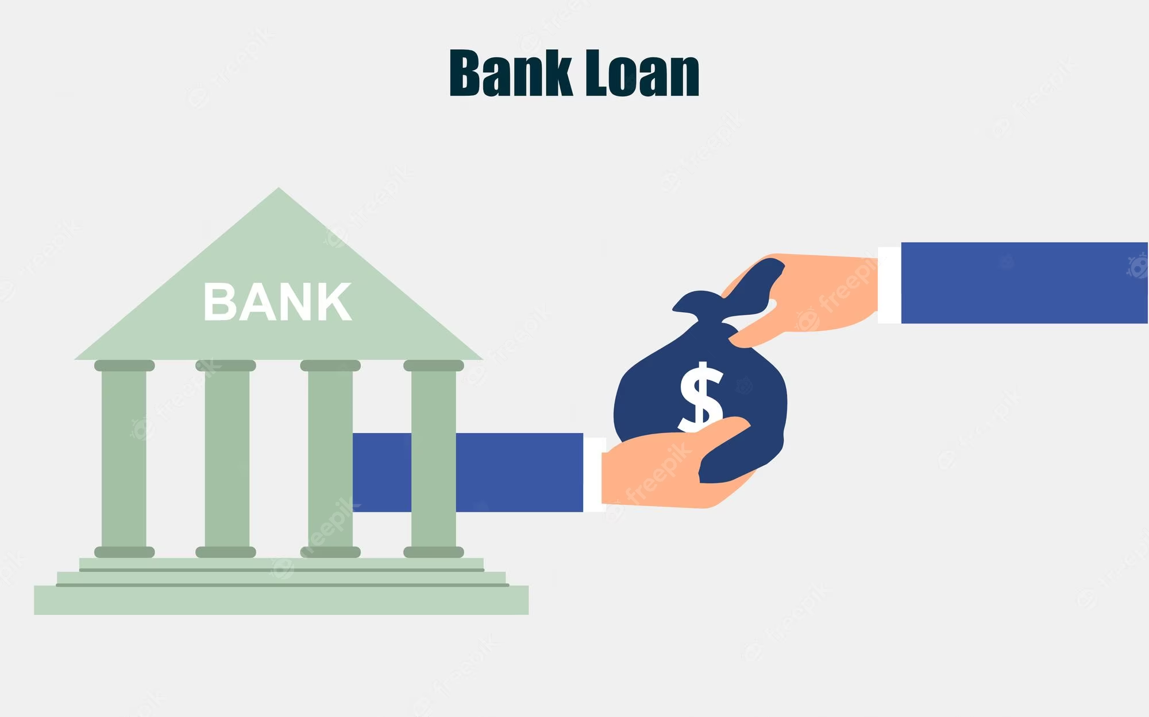

What are the sources of financing that entrepreneurs use for their new businesses?
Kevin Plank
  Personal savings
  Friends and family
  Venture capital
  Bank loans
Notes:
Entrepreneurs use their personal savings or family friends money or lure big investors or take loan for new business

Slide 15
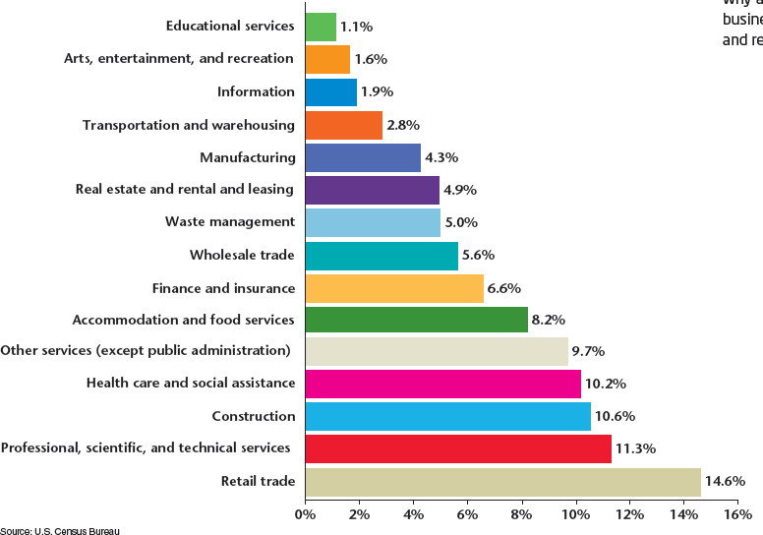
Common Types of Small Businesses as Percent of All Small Businesses
SLIDE 15

Slide 16
BUSINESS PLAN
Business Plan- a written description of the business idea and how it will be carried out.
5 ELEMENTS of a Business Plan:
Description of the business & goals
Customer Analysis- knowing your customer
Operations Plan- organizing the business
Marketing Plan- marketing & advertising
Financial Plan- Creating a Budget: start up, short term & long term

Slide 17

Checkpoint ✓
What are the “strategic alternatives” in a business plan?
  Strategic alternatives are alternative plans for production, staffing, financing, and so on.
  Even the best business plan cannot predict every possible circumstance.
  An alternate plan allows a business to be prepared for the unforeseeable.
SLIDE 17

Slide 18
FINANCING
THE SMALL BUSINESS
Types of financing
  Start-up financing- the money and details of getting the business started: inventory, supplies
  Short-term financing- the money needed for the first year of expenses
  Long-term financing- a 3-5 year plan of success for the business, identify long term financial needs.
SLIDE 18

Slide 19
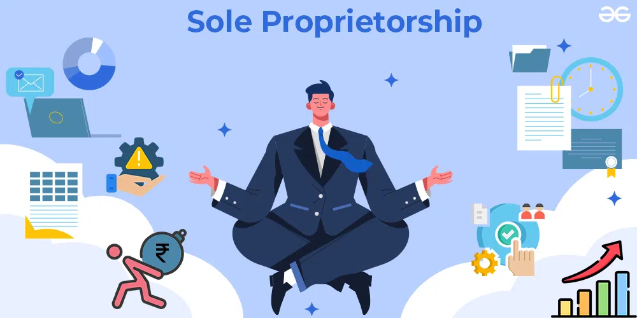


FORMS of BUSINESS OWNERSHIP

Slide 20

Mainly three types of business structure are continuing in Bangladesh.
These are
  Limited Company,
  Partnership Firm and
  Sole Proprietorship.
Limited Companies are two types one is
    Private Limited Company and another is
    Public Limited Company.

Slide 21
SOLE PROPRIETORSHIP
A sole proprietorship is a business with one owner.
It is the simplest business form under which one can operate a business.
It simply refers to a person who owns the business and is personally responsible for its debts
Owner is solely responsible for all liabilities.

Slide 22
MAJOR BENEFITS of SOLE PROPRIETORSHIP
Ease of starting and ending the business
Being your own boss
Pride of ownership
Leaving a legacy
Retention of company profit
No special taxes

Slide 23
DISADVANTAGES of SOLE PROPRIETORSHIPS
Unlimited Liability -- Any debts or damages incurred by the business are your debts, even if it means selling your home, car or anything else.
Limited financial resources
Management difficulties
Overwhelming time commitment
Few fringe benefits
Limited growth
Limited life span

Slide 24
MAJOR TYPES of PARTNERSHIPS
General Partnership -- All owners share in operating the business and in assuming liability for the business’s debts.
Limited Partnership -- A partnership with one or more general partners and one or more limited partners.
http://www.roc.gov.bd/acts/partnershipact1932.html

Slide 25
ADVANTAGES of PARTNERSHIPS
More financial resources
Shared management and pooled skills and knowledge
Longer survival
No special taxes
http://en.banglapedia.org/index.php?title=Partnership_Business

Slide 26
DISADVANTAGES of PARTNERSHIPS
Unlimited liability
Division of profits
Difficult to terminate
Disagreements among partners

Slide 27
CONVENTIONAL CORPORATIONS
Conventional (C) Corporation -- A state-chartered legal entity with authority to act and have liability separate from its owners (its stockholders).
CORPORATIONS
a large company or group of companies authorized to act as a single entity and recognized as such in law.

Slide 28
To form Private Limited Company minimum two and maximum fifty directors required.
On the other hand, for Public Limited Company minimum member should be seven and the maximum is unlimited.
For forming a Joint Venture Company minimum member should be two and maximum fifty. Out of all members minimum, one should be Bangladeshi and minimum one should be Foreigner. In Bangladesh no scope to start a Limited Company by one man.

Slide 29
Corporation
Advantages
Limited liability
More money for investment
Size
Perpetual life
Ease of ownership change
Ease of drawing talented employees
Separation of ownership/management
Disadvantages
Extensive paperwork
Double taxation
Two tax returns
Size
Termination difficult
Conflict with Stockholder & Board
Initial cost

Slide 30
Checkpoint ✓
In addition to owner-supplied capital, what are several other sources of financing for a small business?
  Borrowed money may come from banks, finance companies, or other individuals, such as friends and family.
  Some suppliers may also be willing to extend credit.
SLIDE 29

Slide 31
Entrepreneur- ONLINE RESEARCH
WHO INSPIRES YOU?
WHAT IDEAS INSPIRE YOU?

